Slide 1





Java User Group Thüringen
2. Meetup
organisiert im
Sponsoren:
Intelligent Software Systems

Slide 2
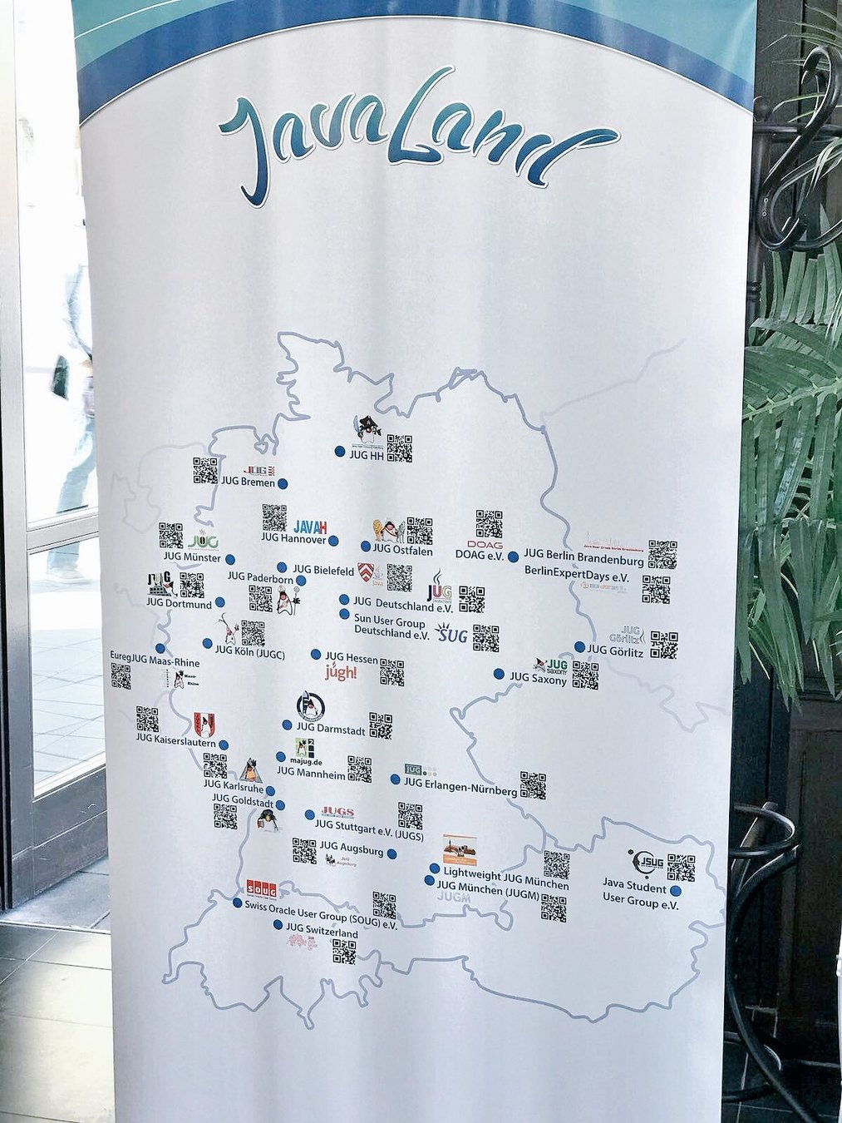

Slide 3
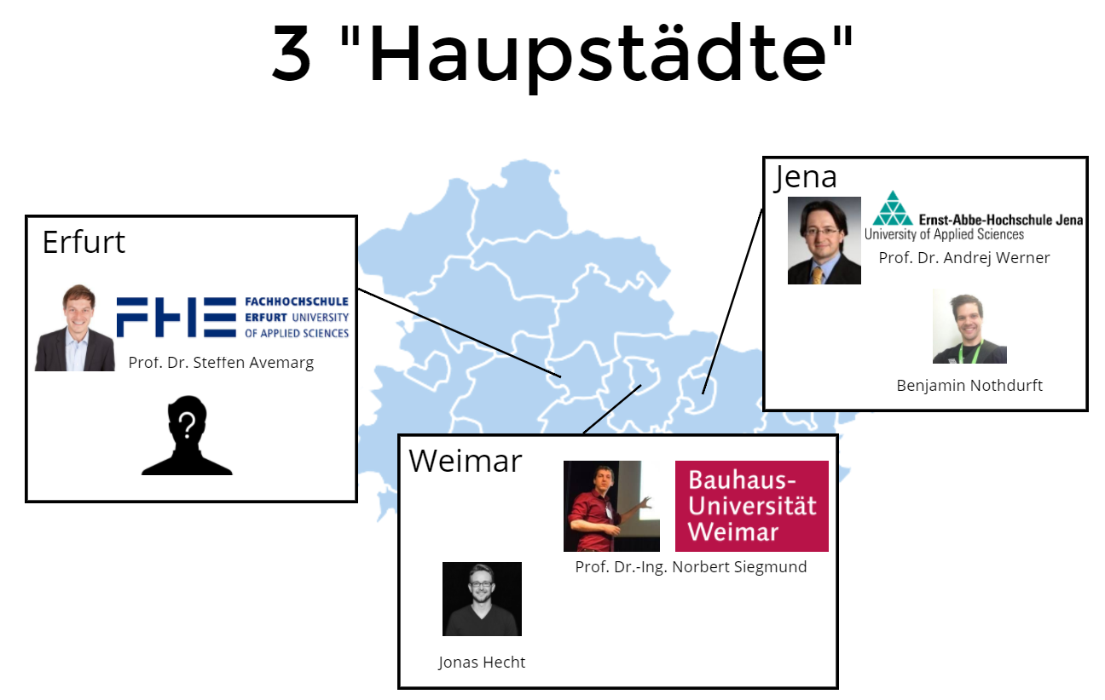

Slide 4

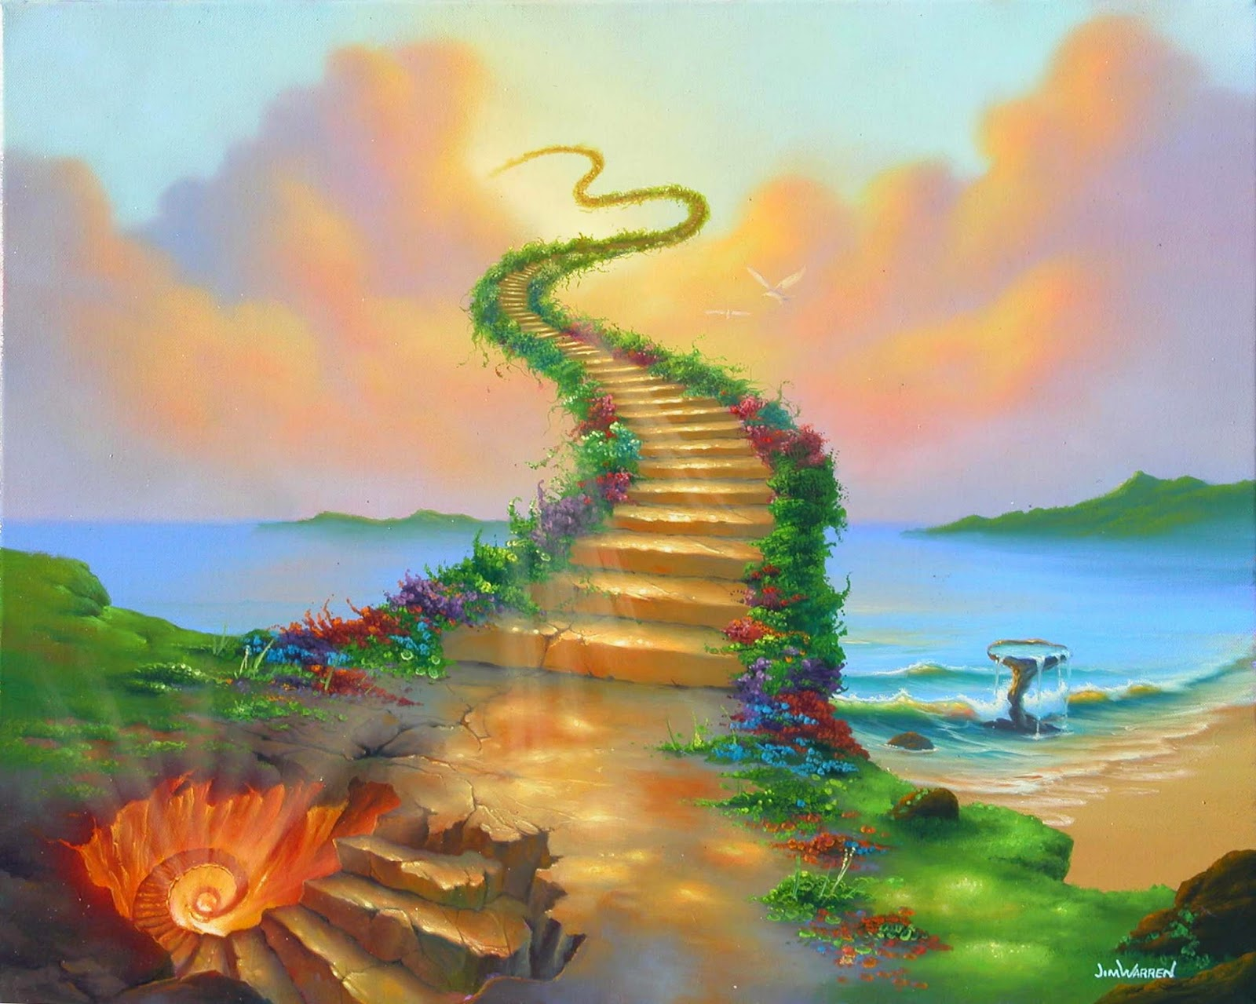
Studenten treffen Entwickler

Slide 5
meetup.com/jug_th

Slide 6
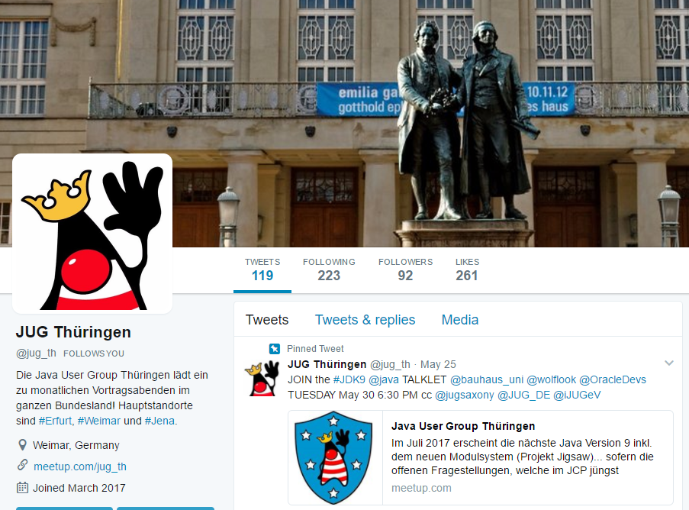
twitter.com/jug_th

Slide 7
Upcoming Talks!
Reinhard Prechtl (JUnit 5, codecentric)
Wolfgang Weigend (JDK 9, Oracle)
Miroslav Wengner (JCP oder robo4J)
Oliver Gierke (REST API Design), Mark Heckler (Spring)
Eberhard Wolff (Microservices & Self-Contained Systems)
Kelly Goetsch (Microservices in eCommerce, API first)
Dr. Michael Menzel (Reactive, Hystrix, RxJava)
David Schmitz (javaslang), Jochen Mader (Vertex)
Christoph Engelbert (Hazelcast), Frank Sippach (JVM Langs)
Manuel Mauky (GraphQL), Sandra Parsick (IT Automation)
Marcus Biel (CleanCodeAcademy, JCrete Bericht)
Carola Lilienthal (DDD, Software Architecture)
Henning Schwenter (Java Value Types)
Jan Lohmüller (Reactive Java), Michael Simons (Spring Starters)
Hendrick Ebbers (Useful Java APIs)
Christian Kümmel (Rapid Eclipse)
Thorben Jansen (Hibernate)
Gregor Trefs (Combinator als fkt. Entwurfsmuster)
Sven Ruppert (Vaadin), Sebastian Daschner (Java EE) ...

Slide 8


Slide 9
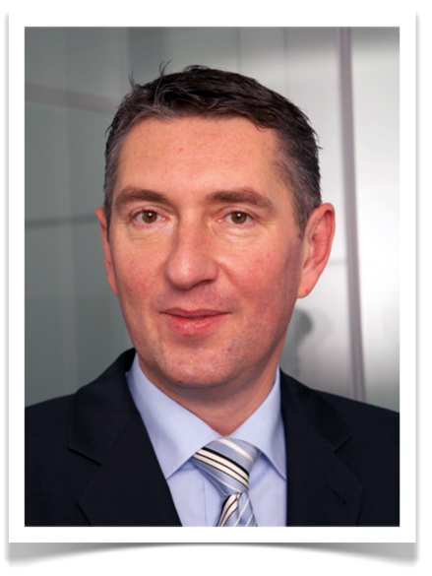

Wolfgang Weigend Master Principal Sales Consultant bei der Oracle Deutschland GmbH

